Slide 1

Notes:
- We have all been here - We are excited to ship the next version - What is in it? - What problems have we solved? - What bugs have we addressed? - What features are we excited about shipping? - How do we communicate these to our end users?

Slide 2


Slide 3


Slide 4
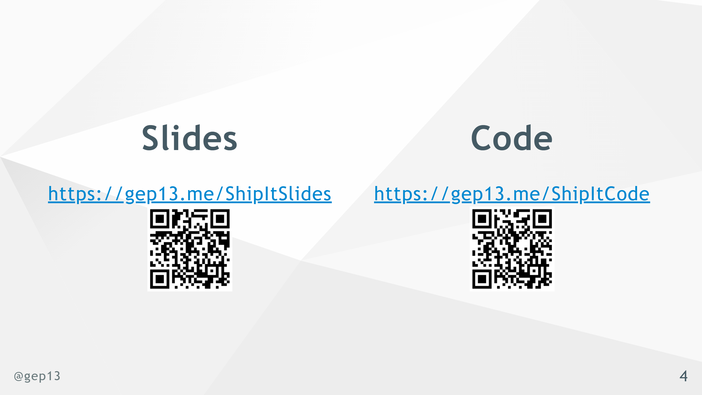
Notes:
- Cake build script sample for running GitVersion and GitReleaseManager is in the repository

Slide 5
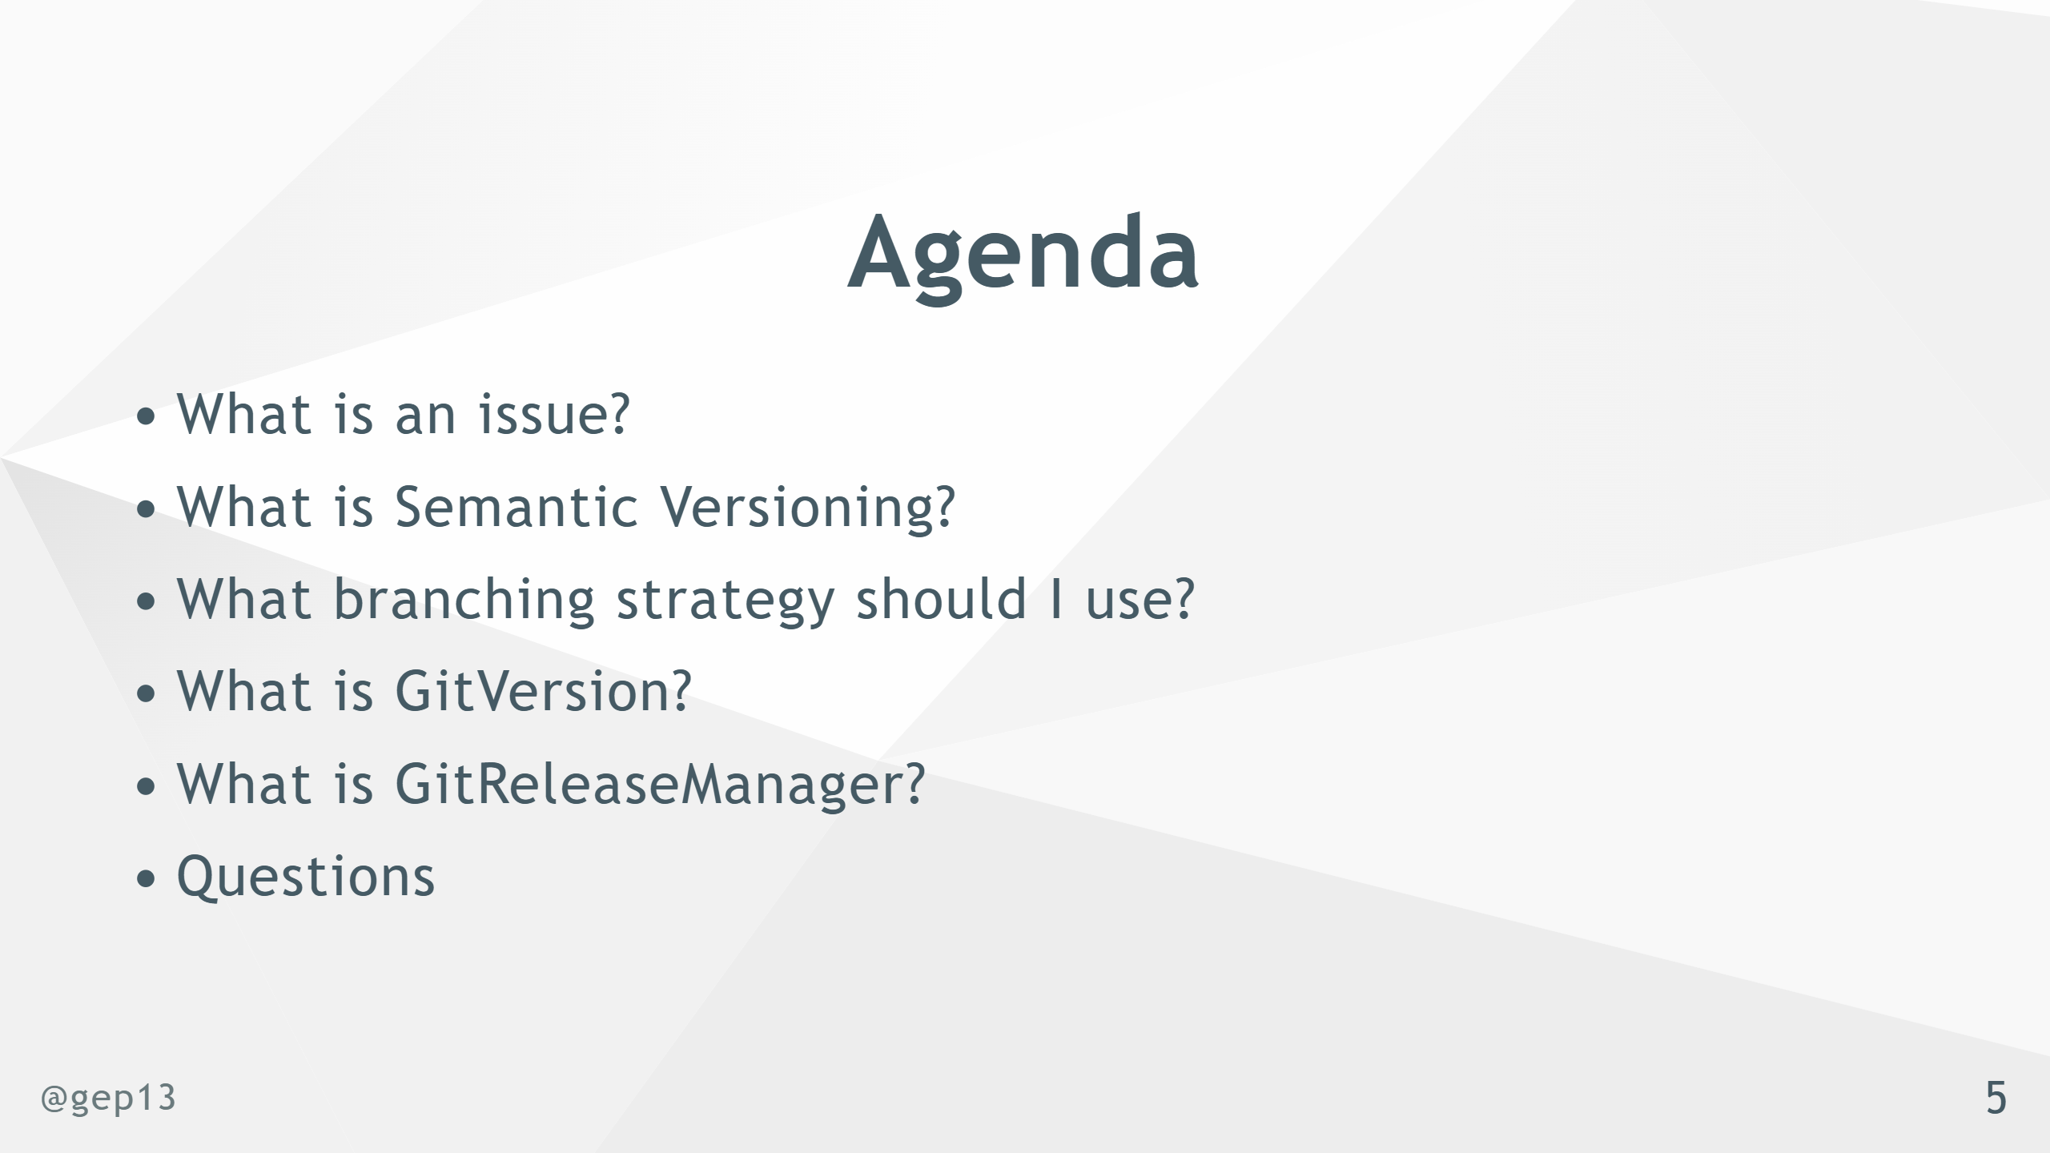
Notes:
- Fundamental principal - traceability and communication - What version number does it have? - What issues/pull requests are associated with it?

Slide 6


Slide 7
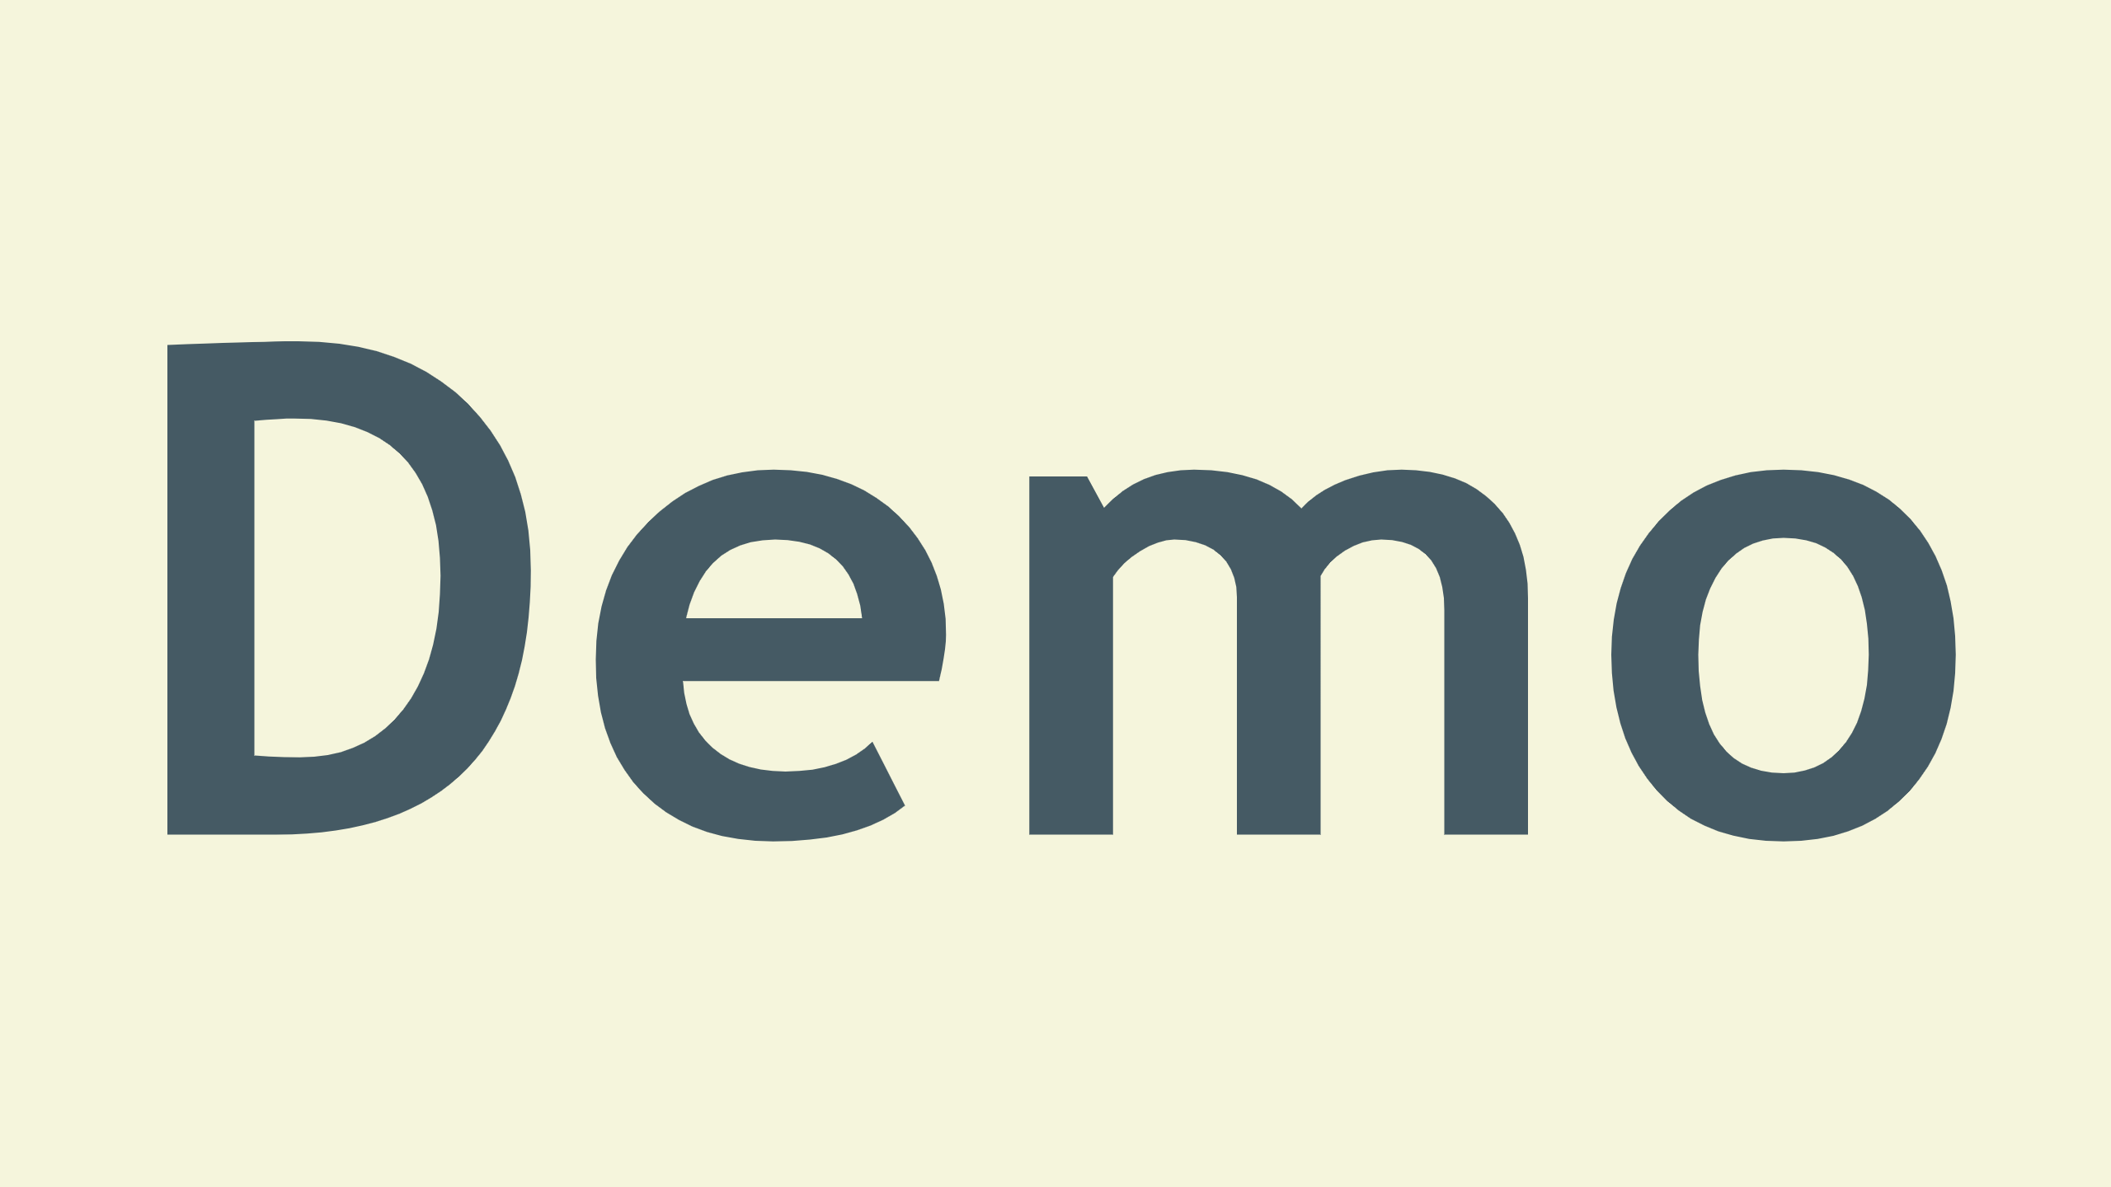
Notes:
- Single point of truth for information - Both for developers and users - Where we can trace changes associated with the issue - Where we can communicate changes about the issue

Slide 8
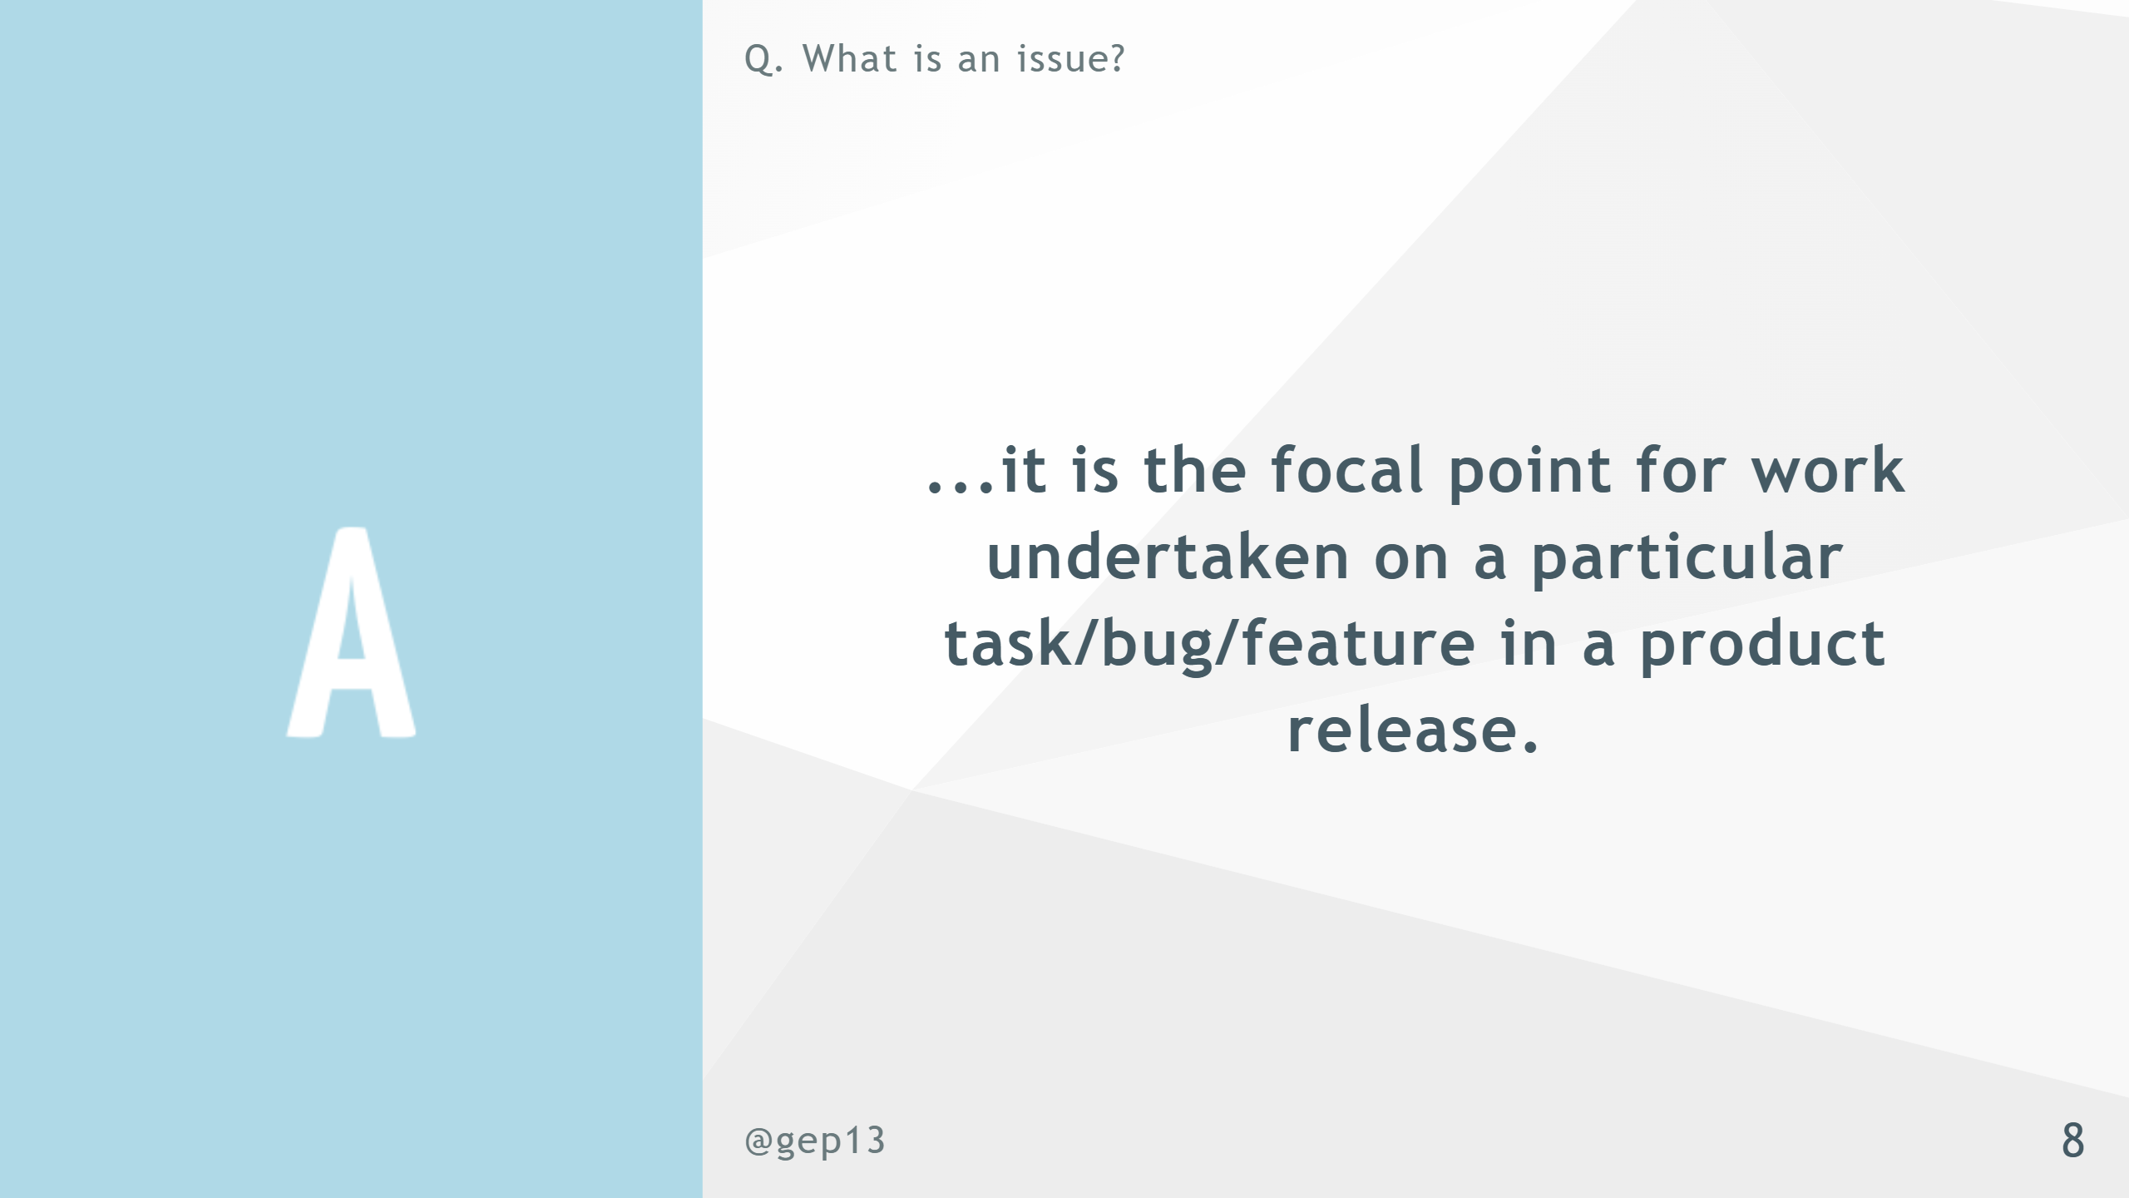

Slide 9
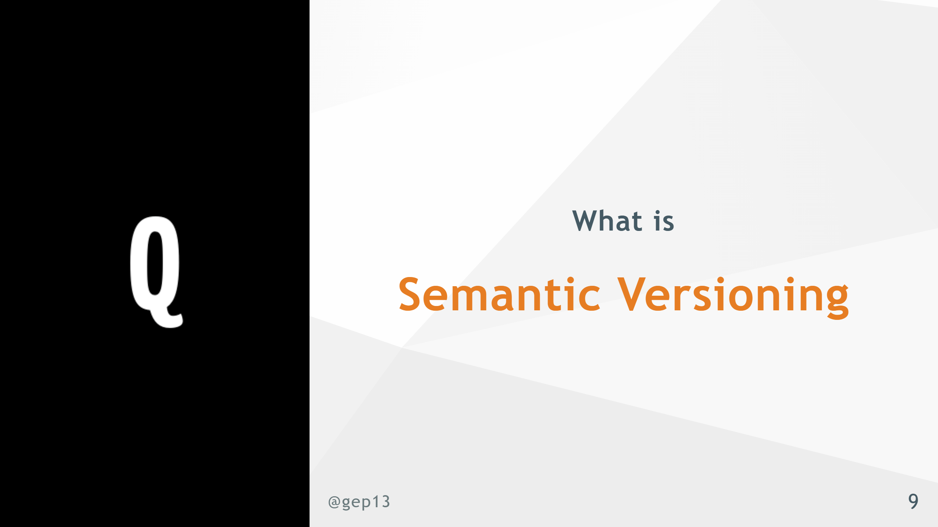

Slide 10
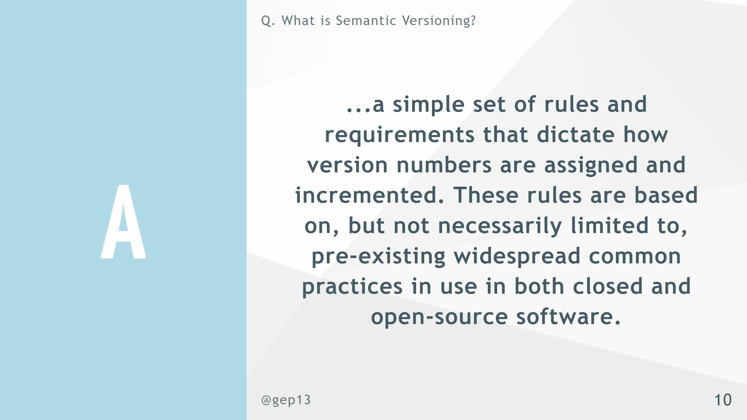
Notes:
- Loaded topic - large discussion - Not going into the details

Slide 11
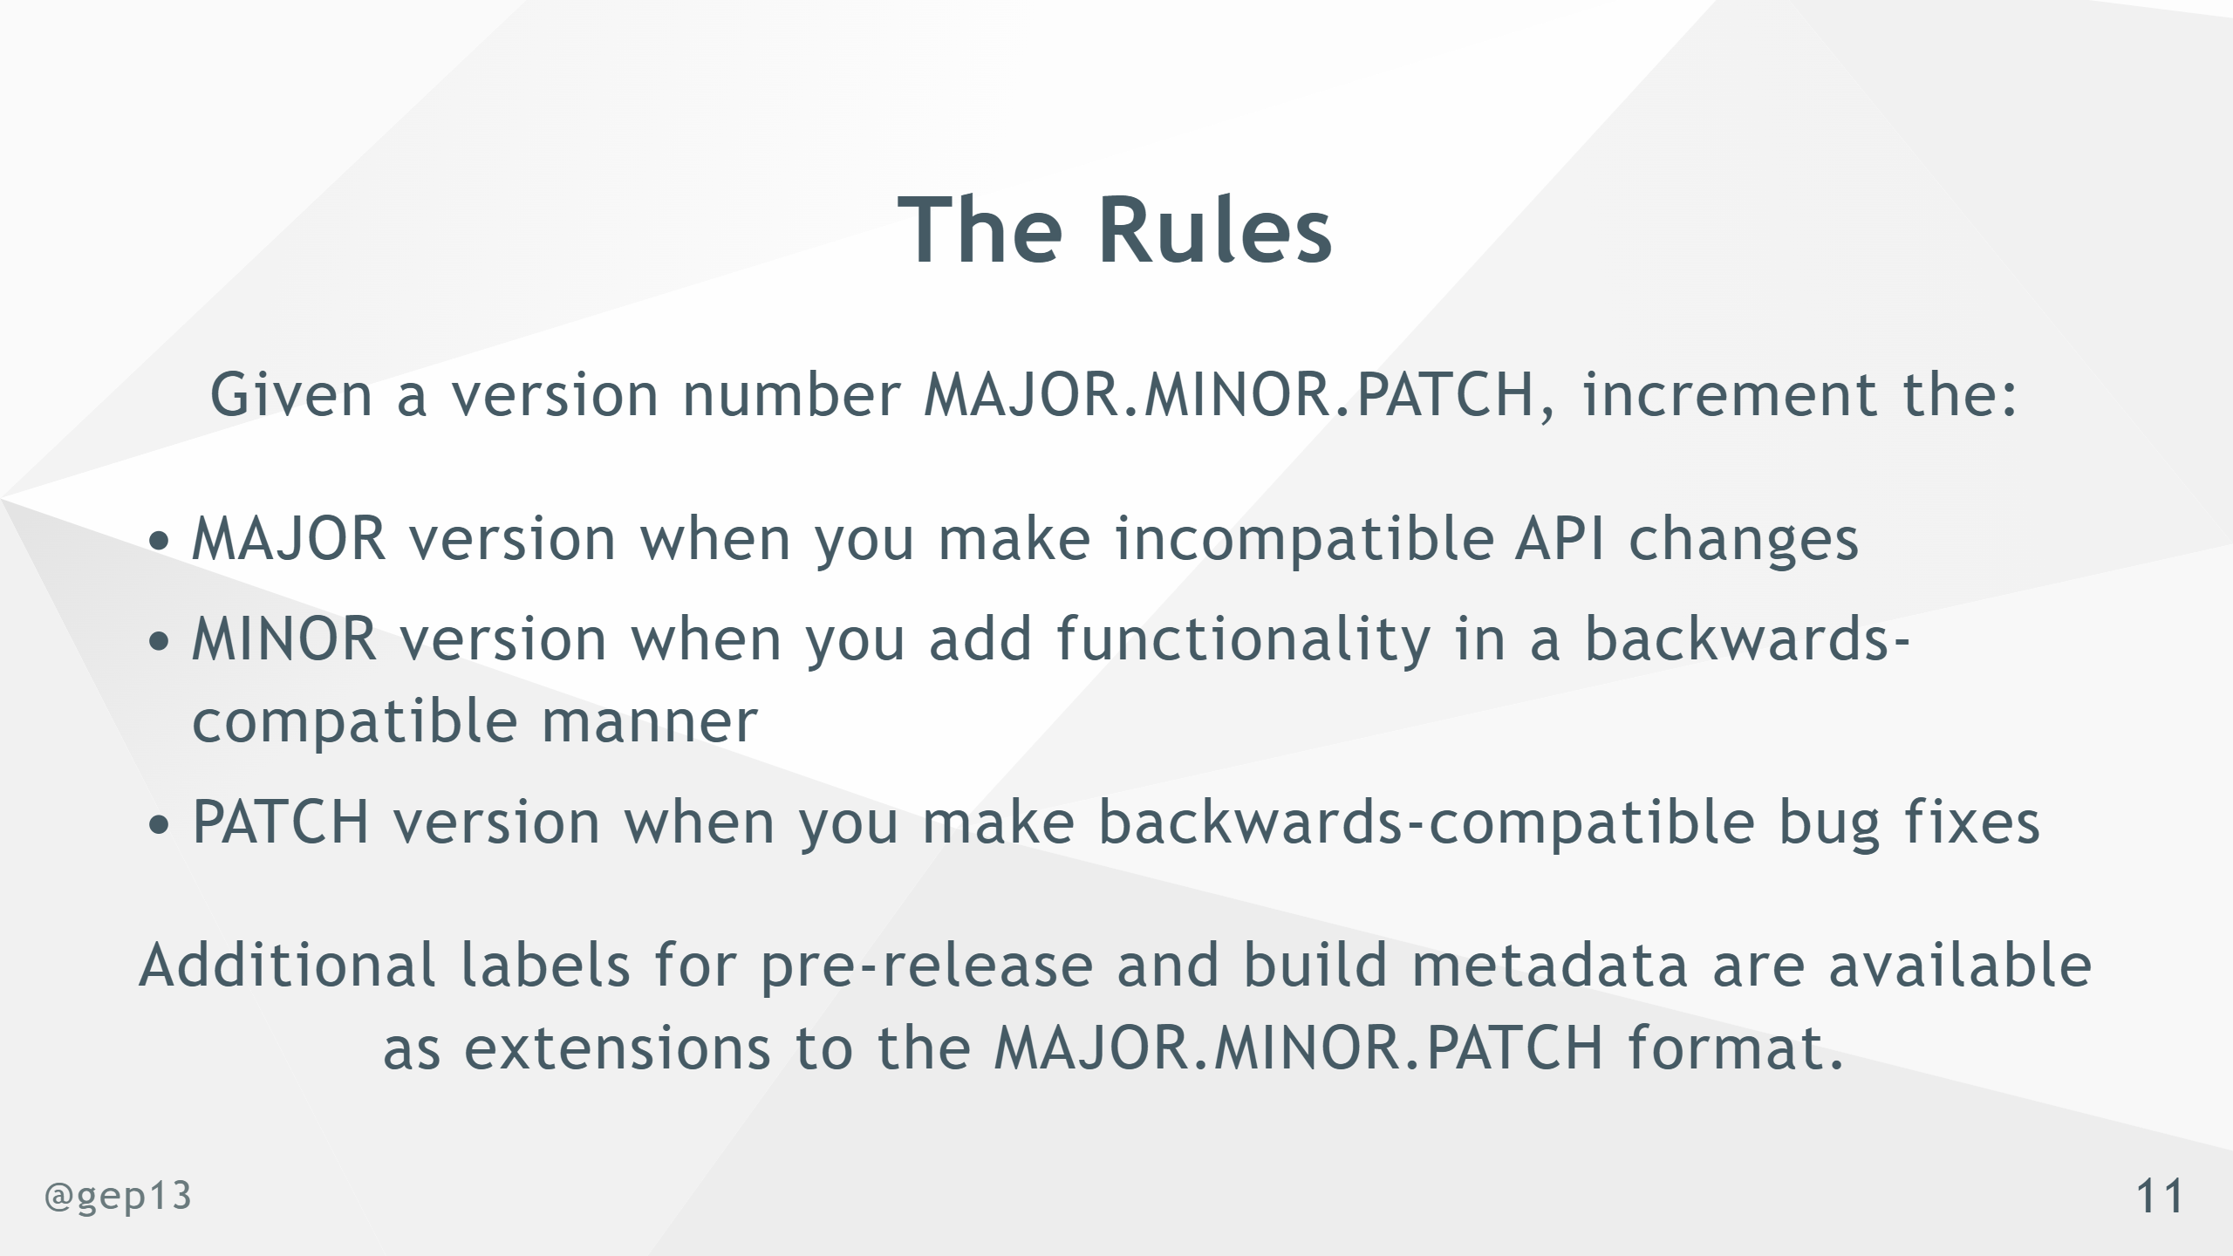
Notes:
- A semantic version number expresses the intention of the release - What has changed since the last version

Slide 12
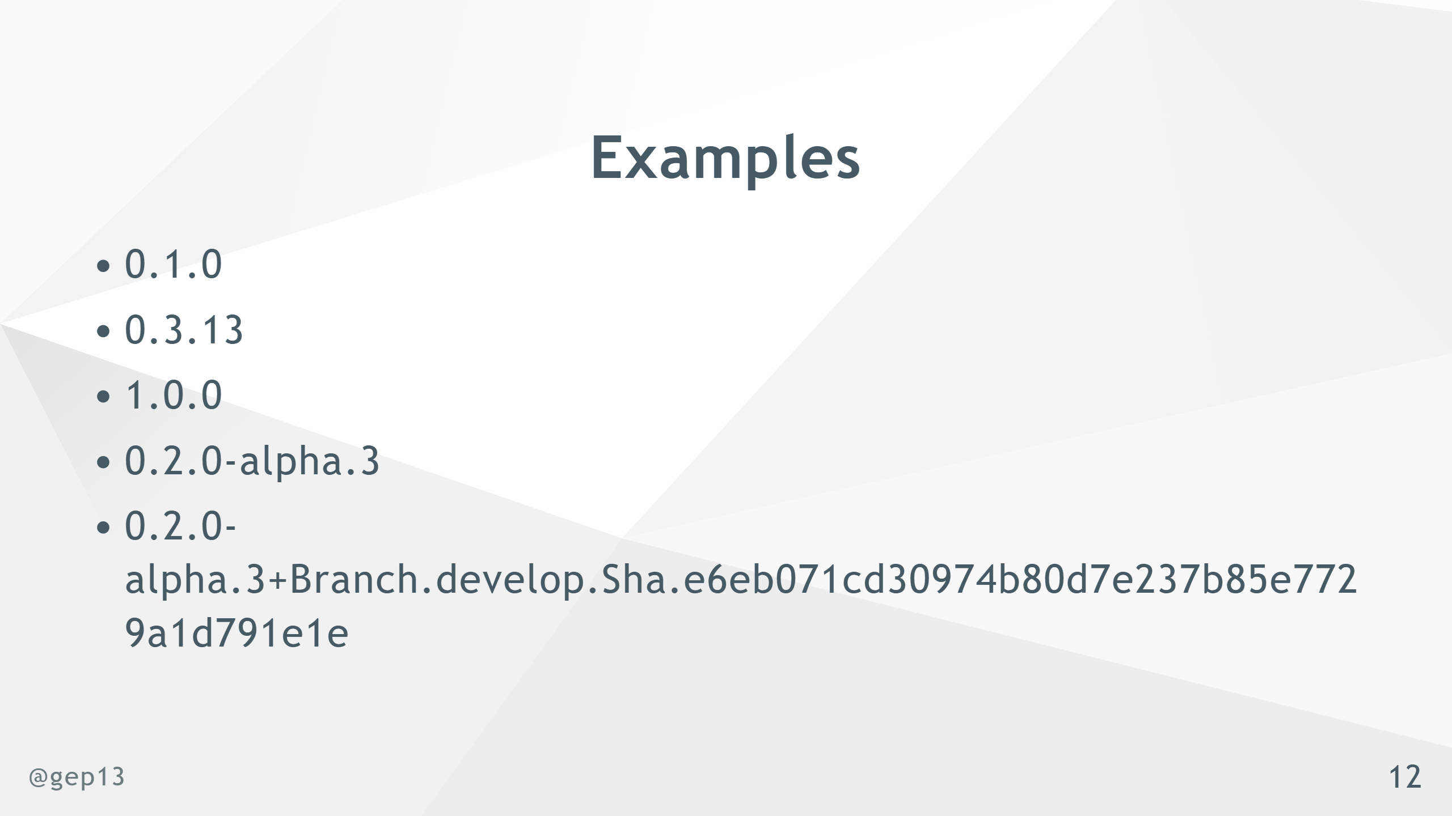
Notes:
- Final example here has ALL information needed for the purposes of traceability - Most common to have both a "short" version for normal usage, and use the full version as an informational version

Slide 13
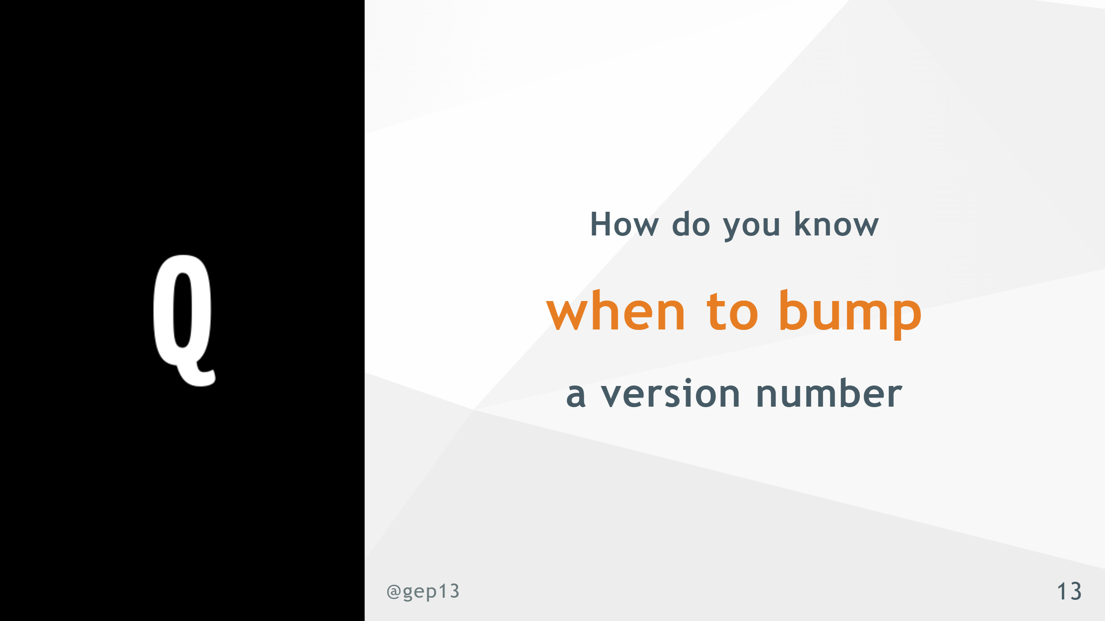

Slide 14
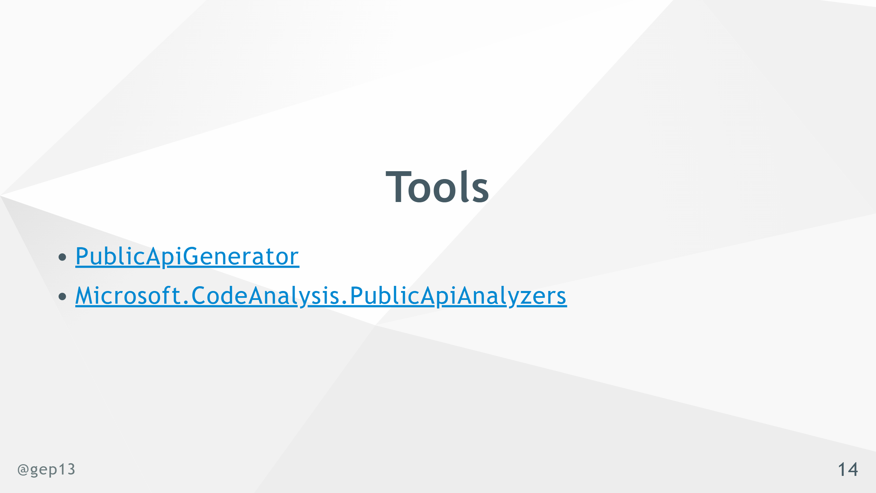
Notes:
- There is no magic bullet here - These tools definitely help in keeping you "honest" about the changes going into a given release - There may be marketing reasons why a certain version number is needed

Slide 15
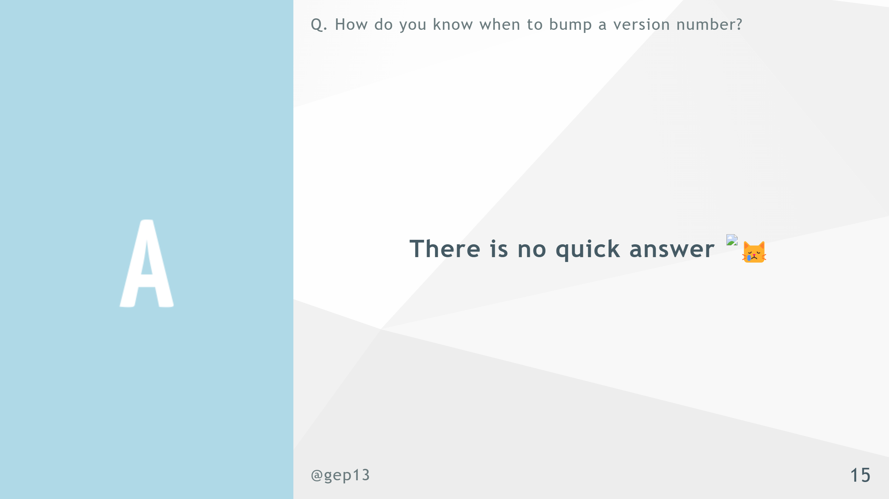

Slide 16

Notes:
- Again a loaded topic

Slide 17

Notes:
- This is the simpler of the two strategies that I am going to show

Slide 18
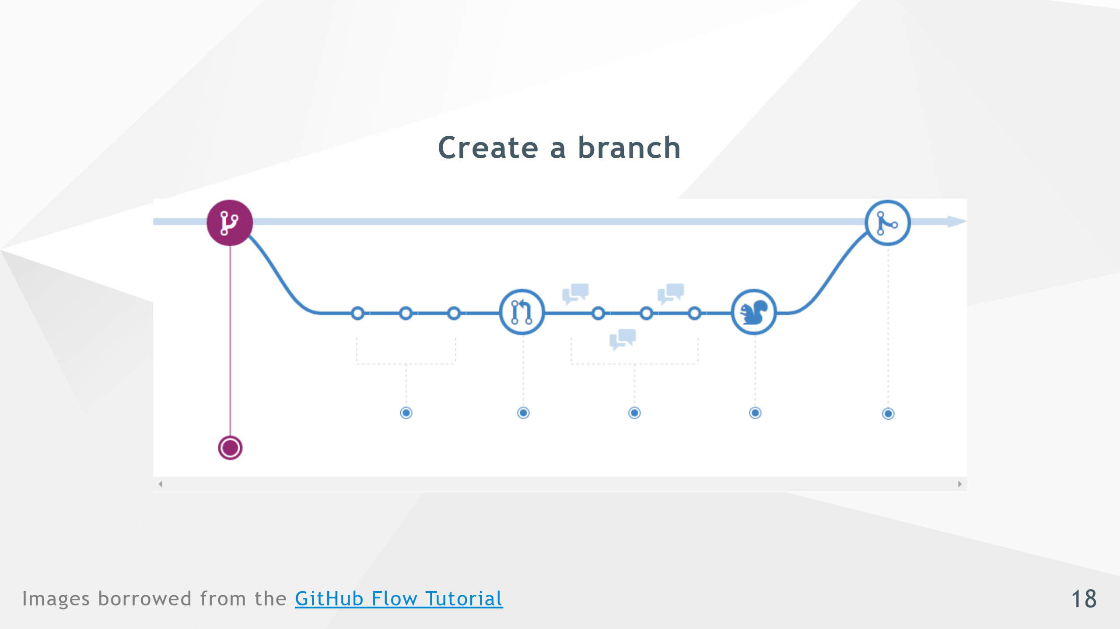

Slide 19
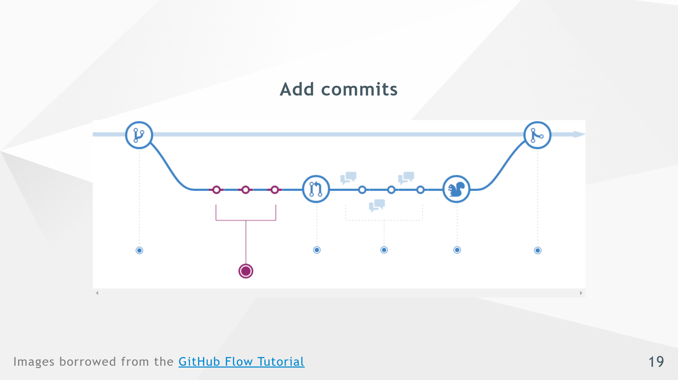

Slide 20
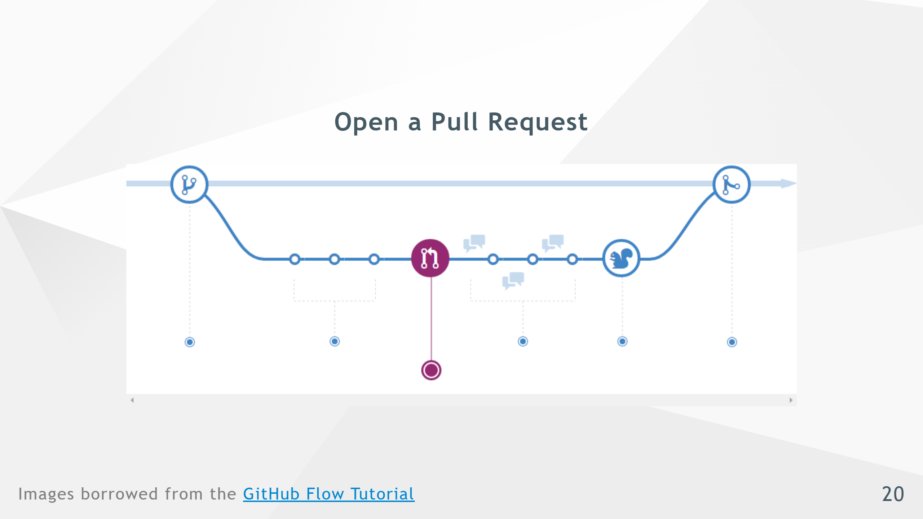

Slide 21
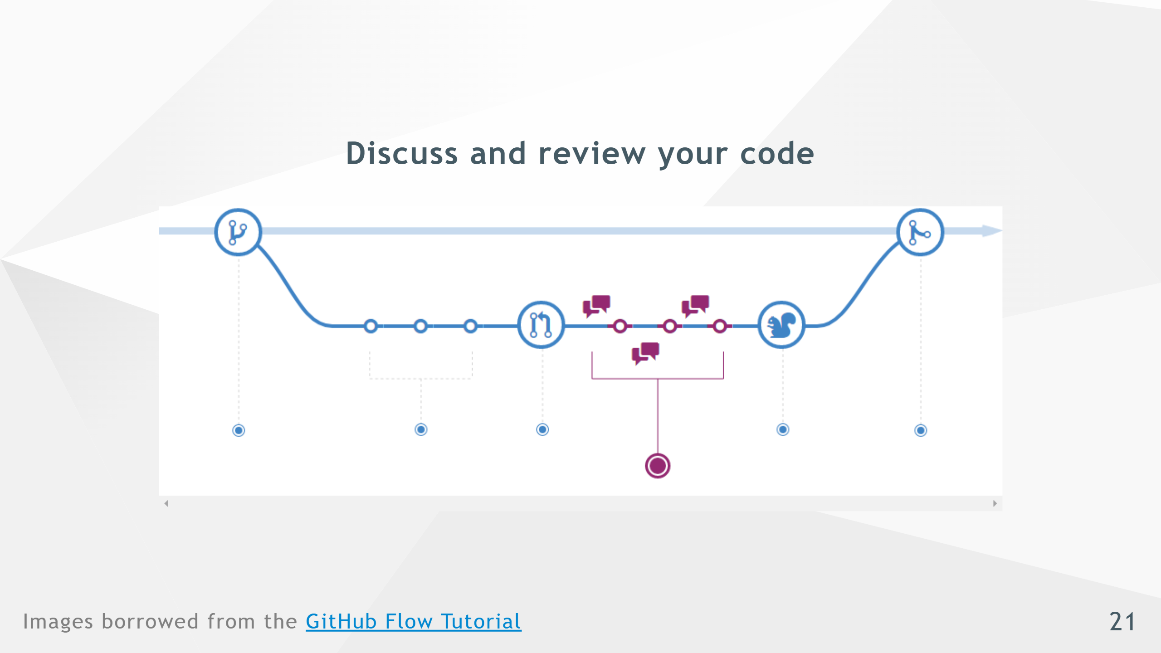

Slide 22
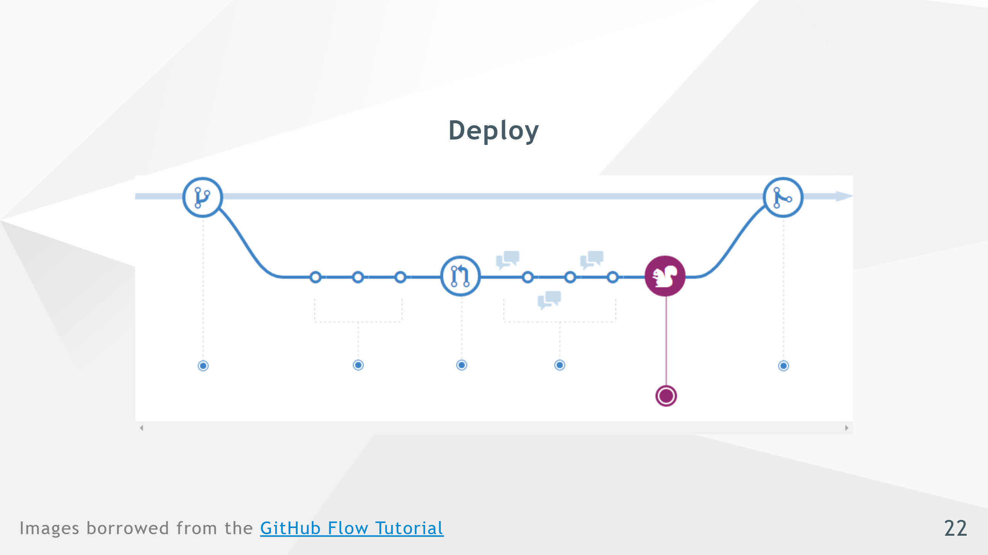

Slide 23
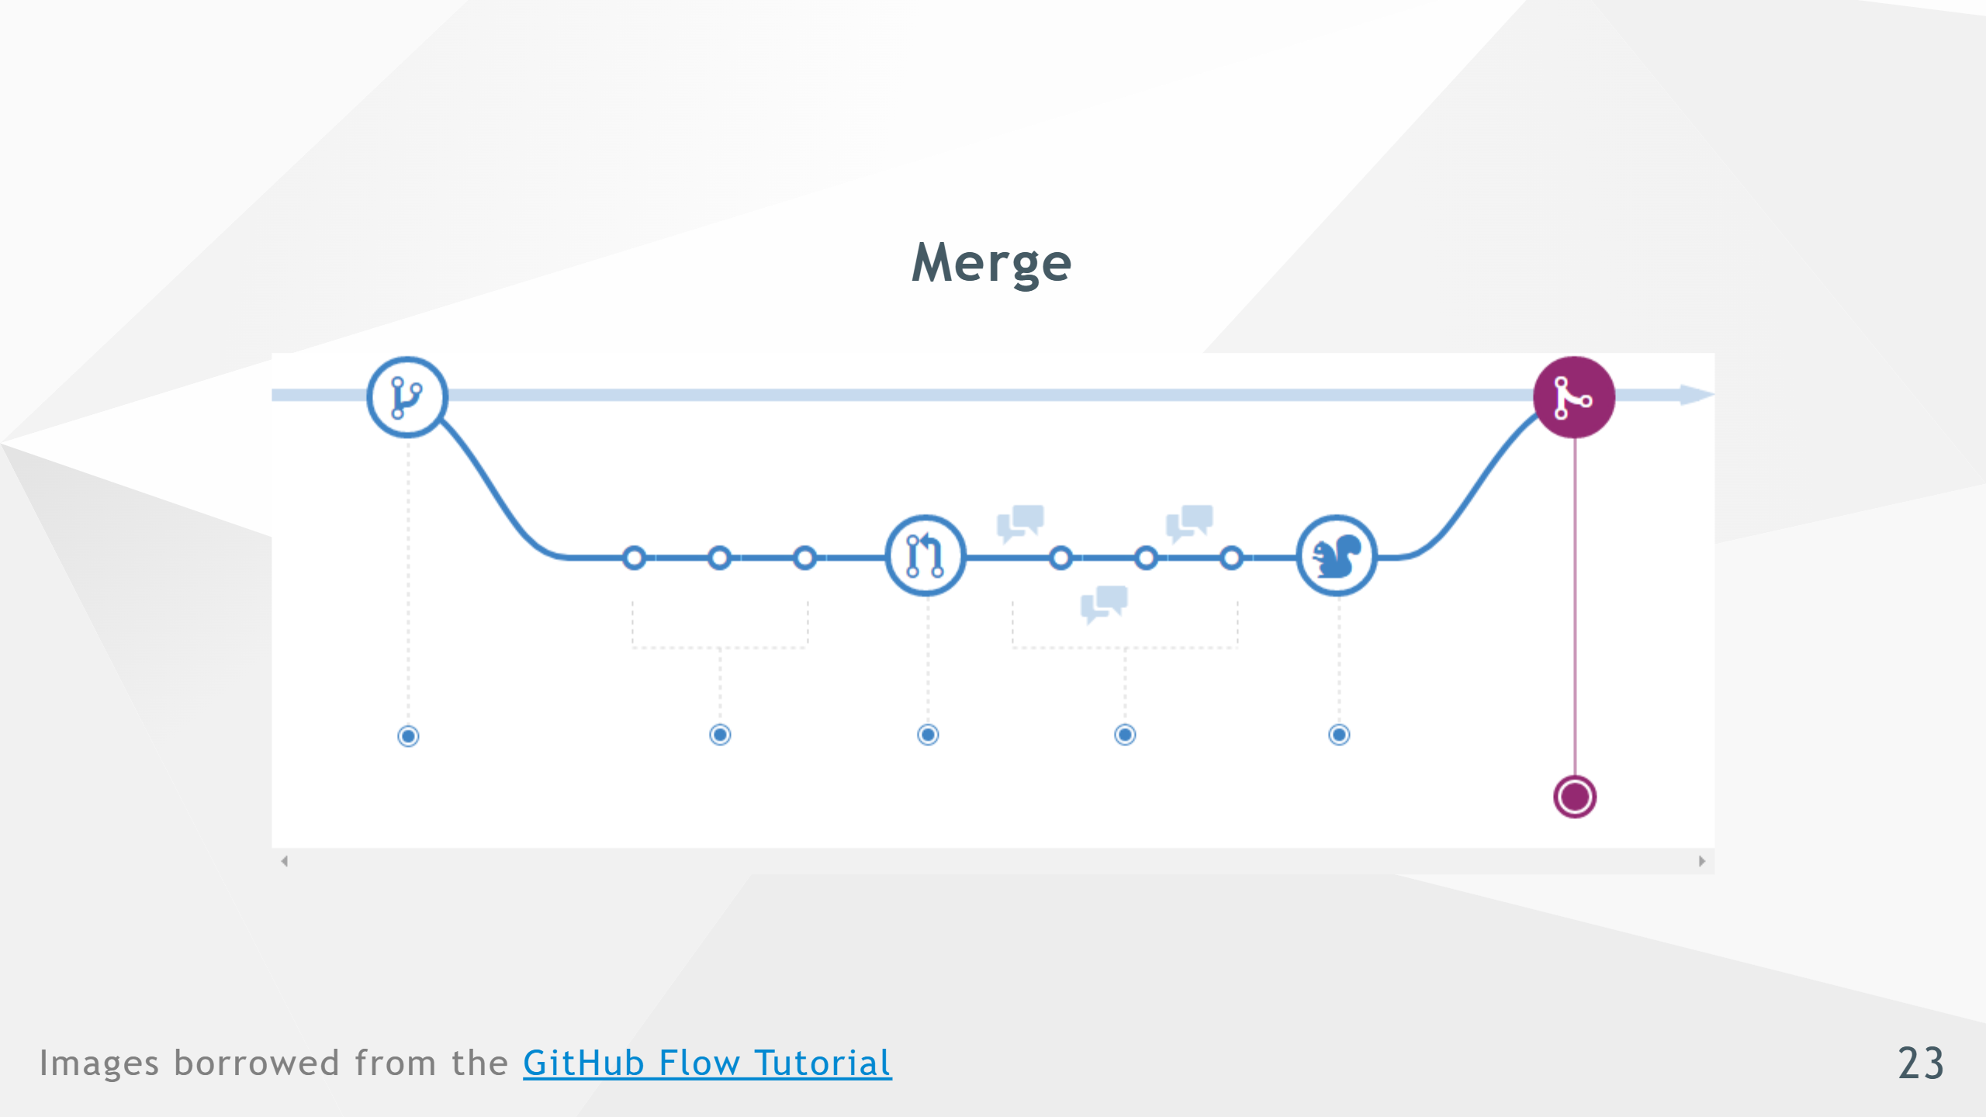

Slide 24

Notes:
- This is the more complicated strategy, but also the one that I prefer

Slide 25
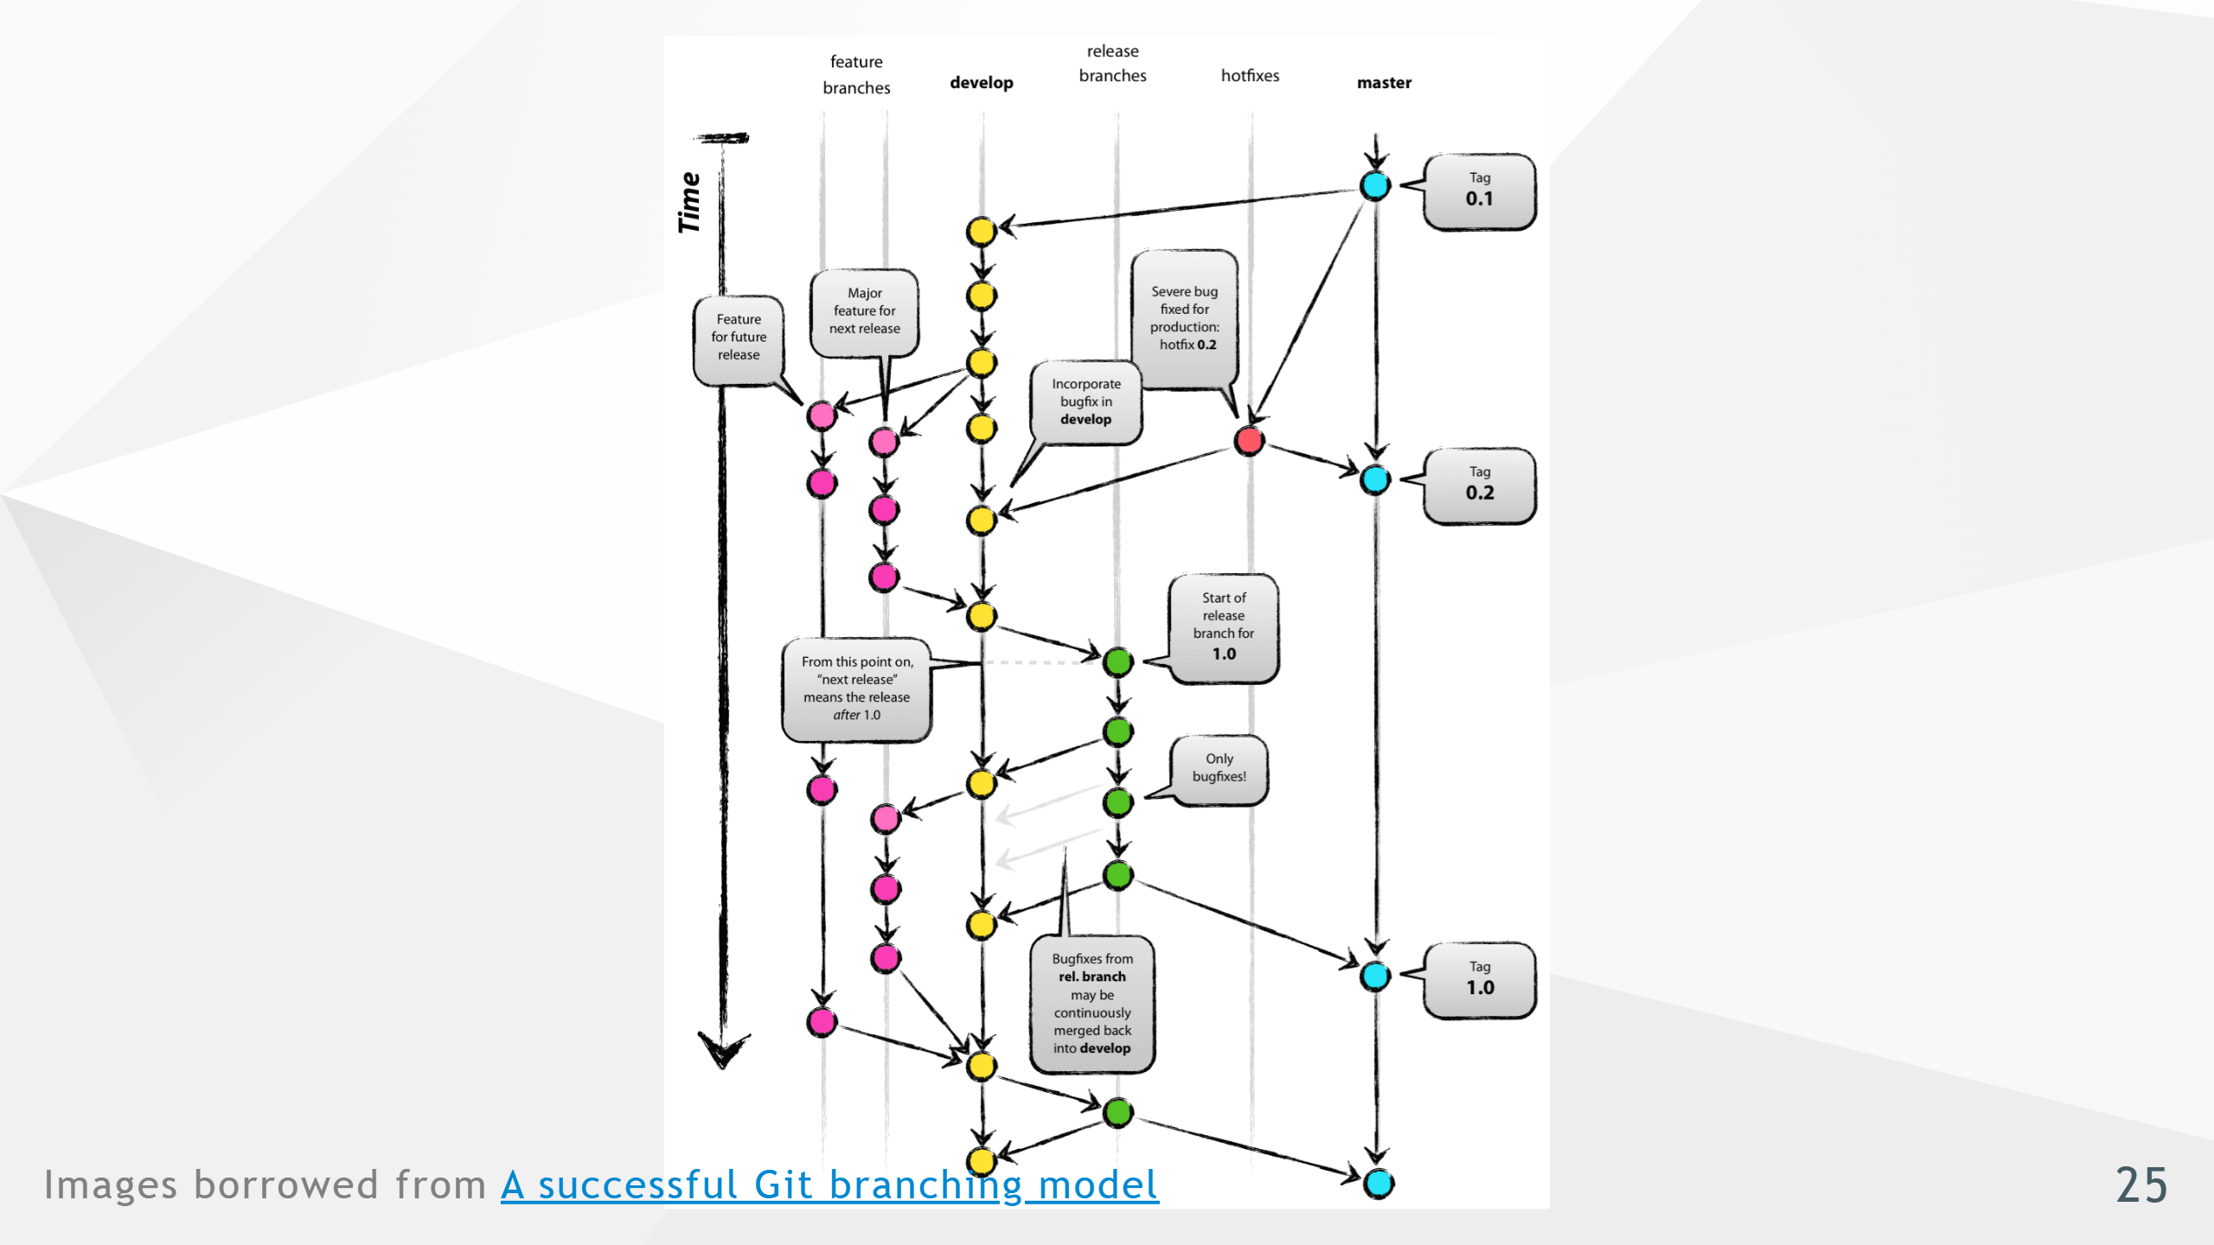

Slide 26
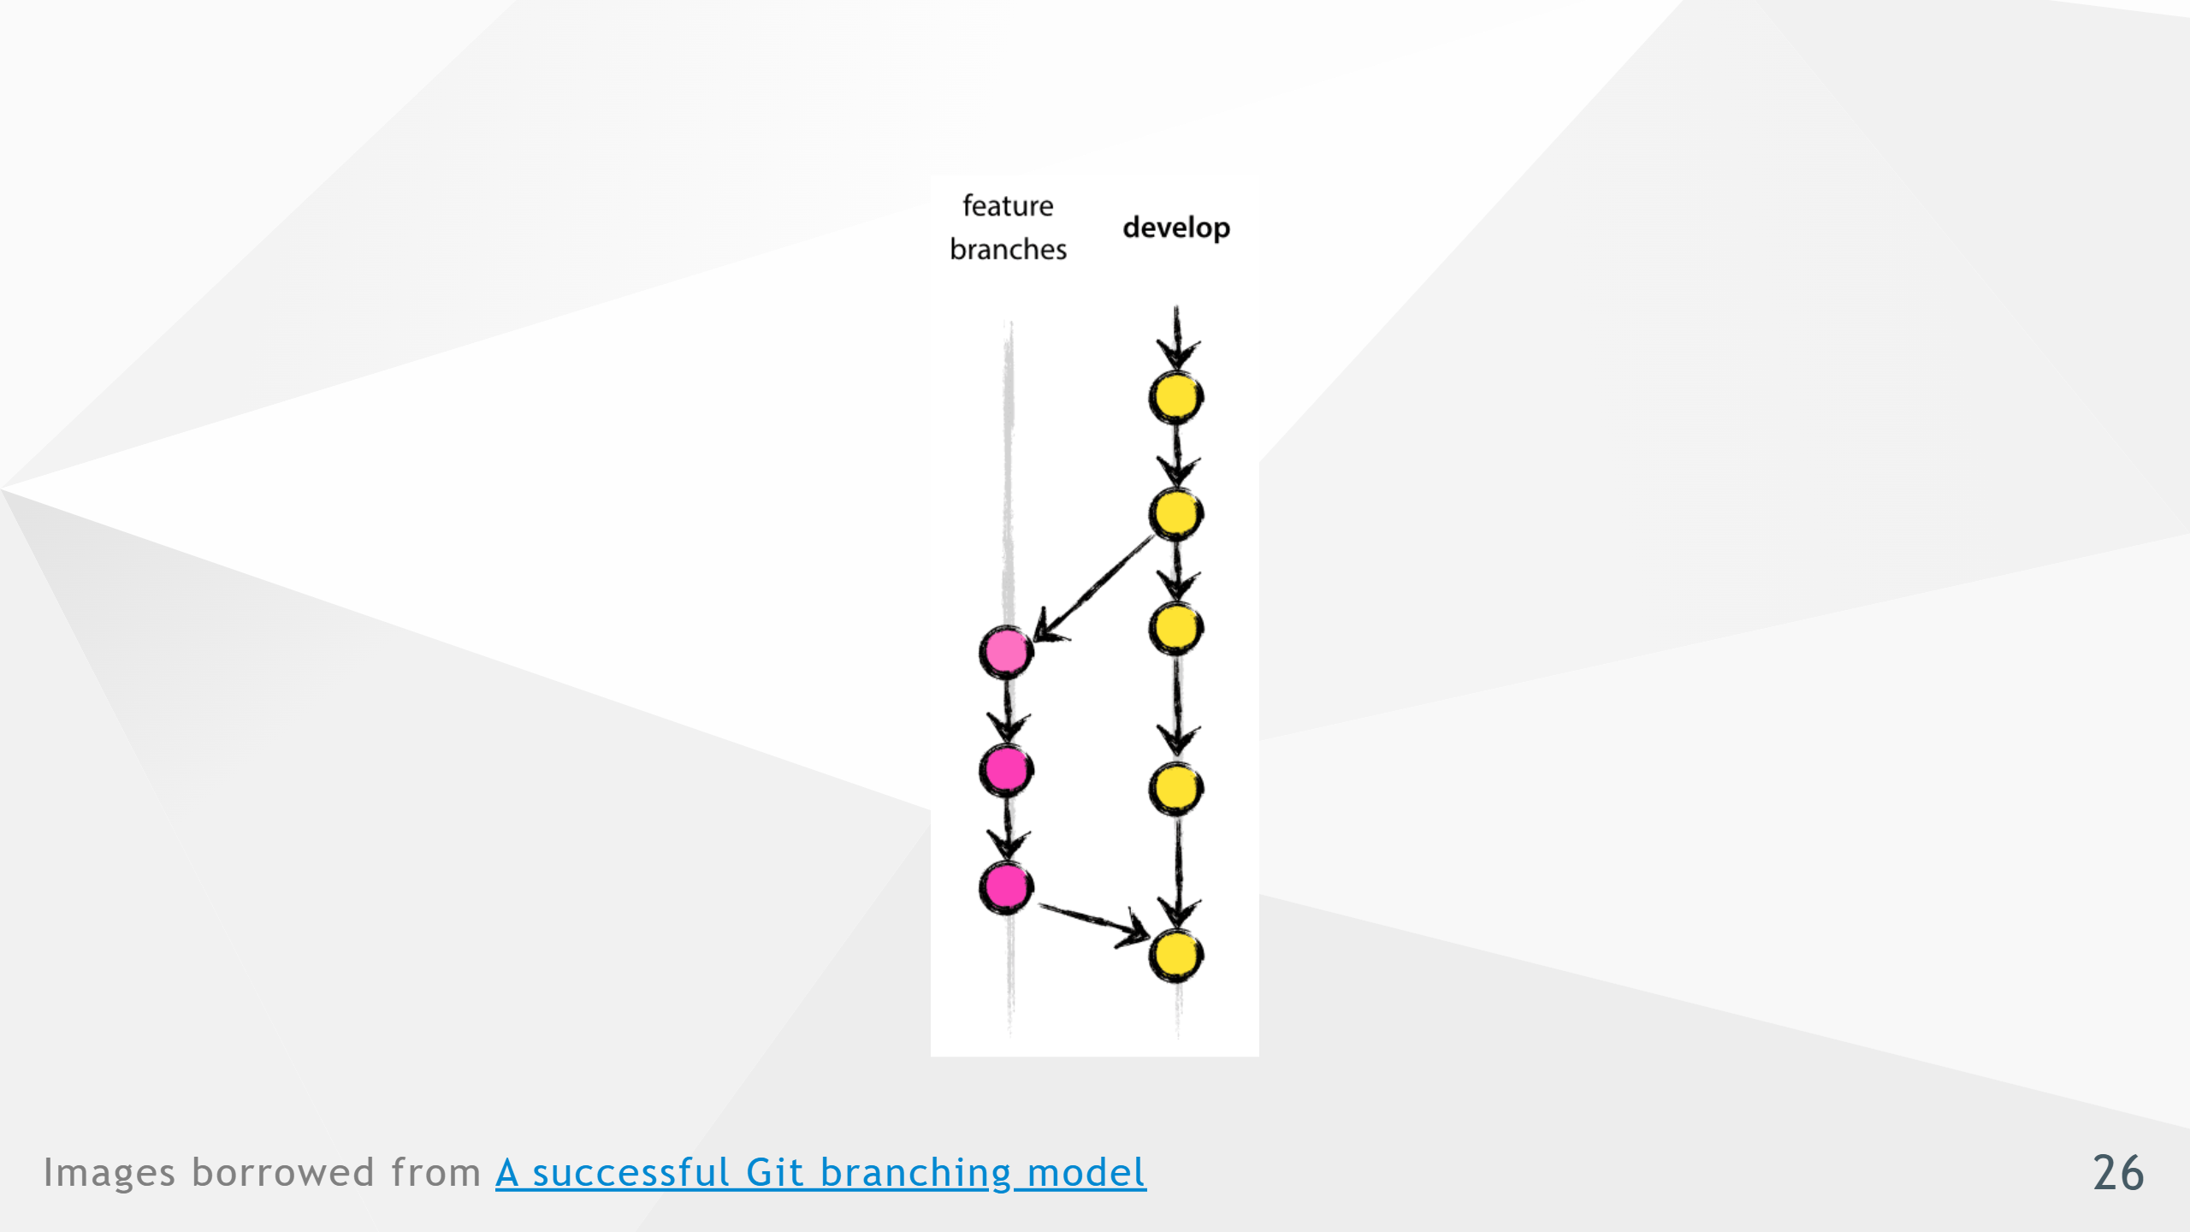
Notes:
- Even though it appears more complicated - Once you break it down, the process is very similar to GitHub Flow - If you squint your eyes a bit!

Slide 27
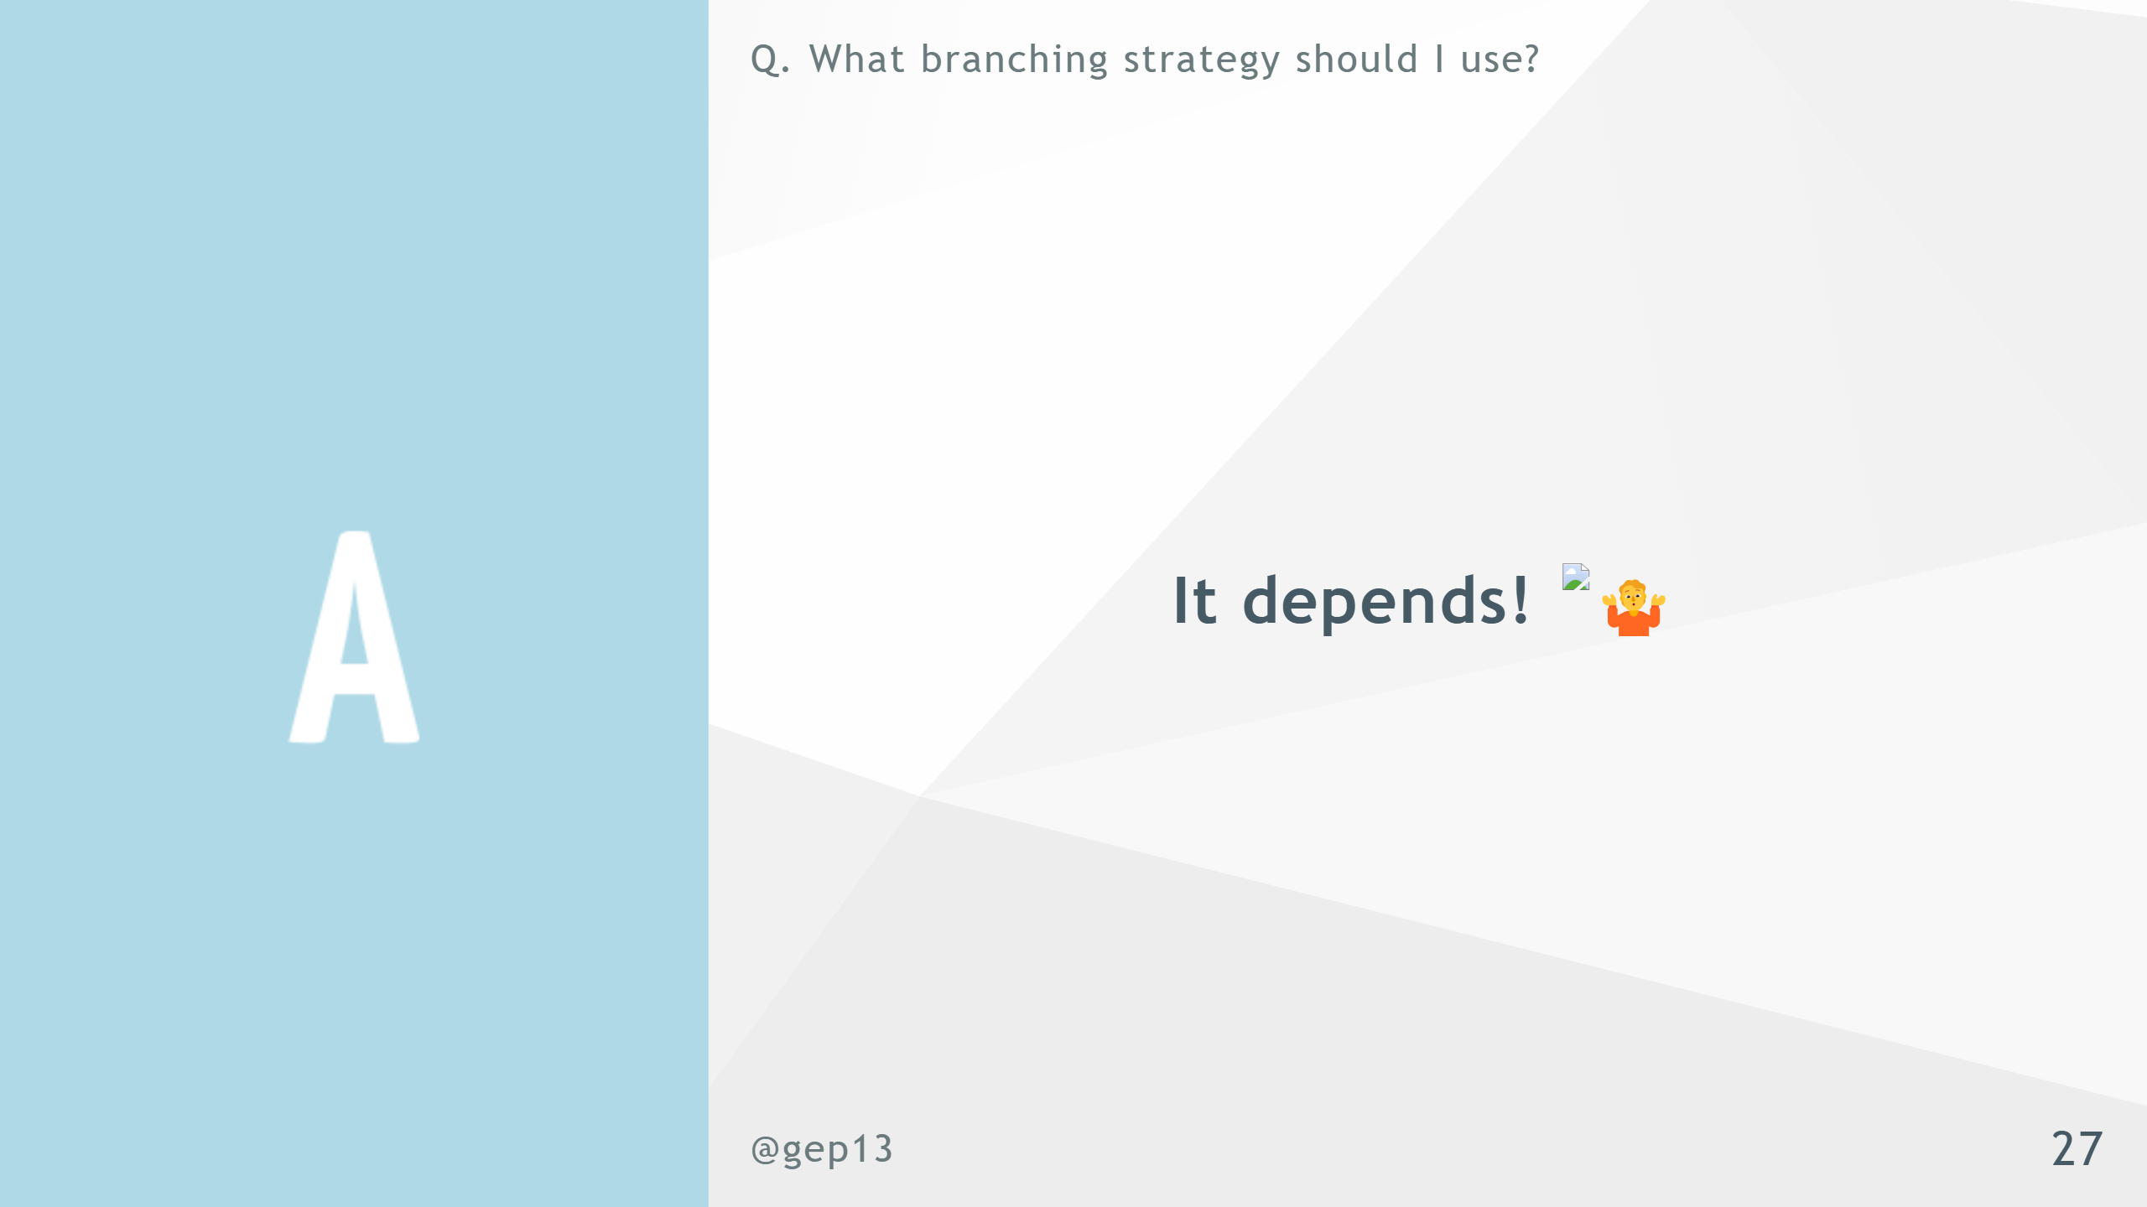
Notes:
- Again, there is no magic bullet - Pick the workflow that works for your team - Document it, so that everyone knows what to expect

Slide 28


Slide 29
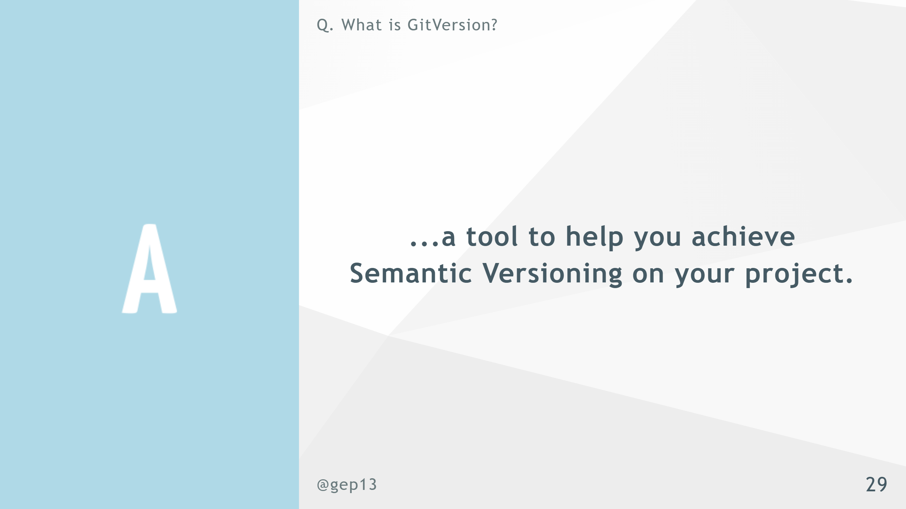
Notes:
- .Net Framework - .Net Global Tool - GitHub Action - Doesn't help you decide when a version number need to change

Slide 31


Slide 32
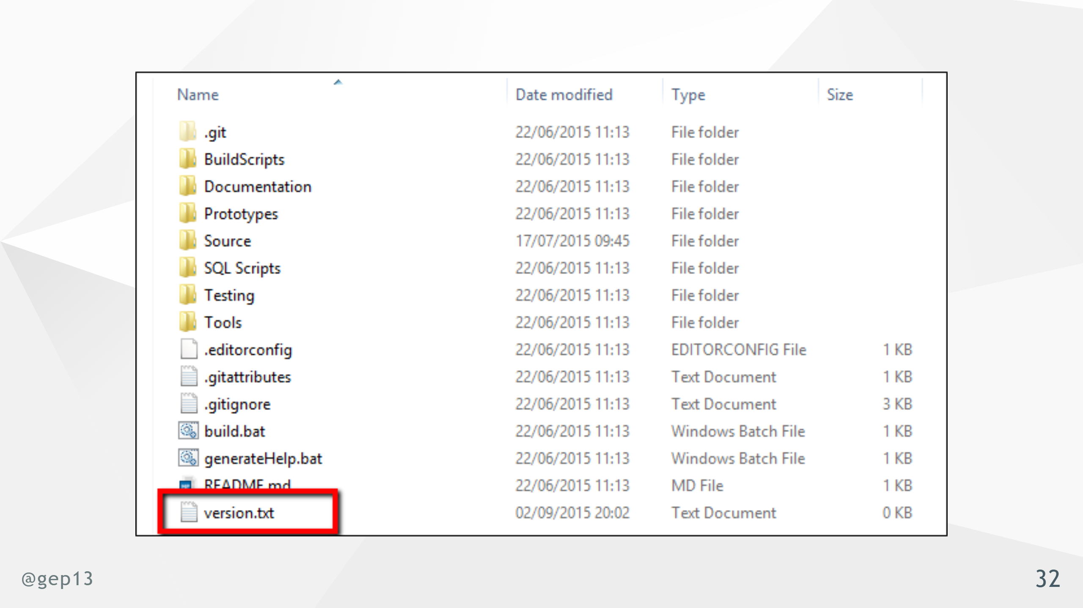

Slide 33
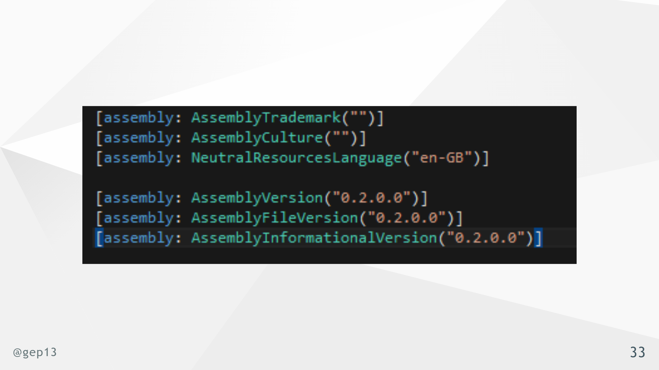

Slide 34
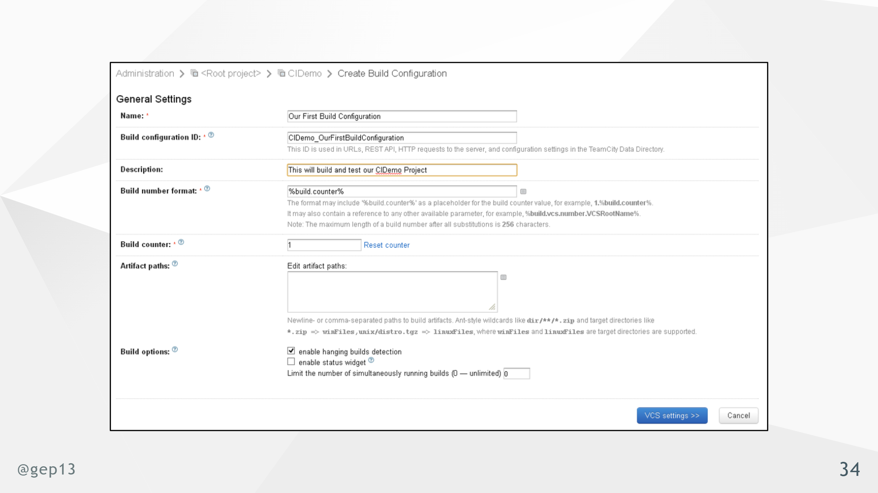
Notes:
- This couples you to a CI system

Slide 35

Notes:
- No idea what the version number is

Slide 36
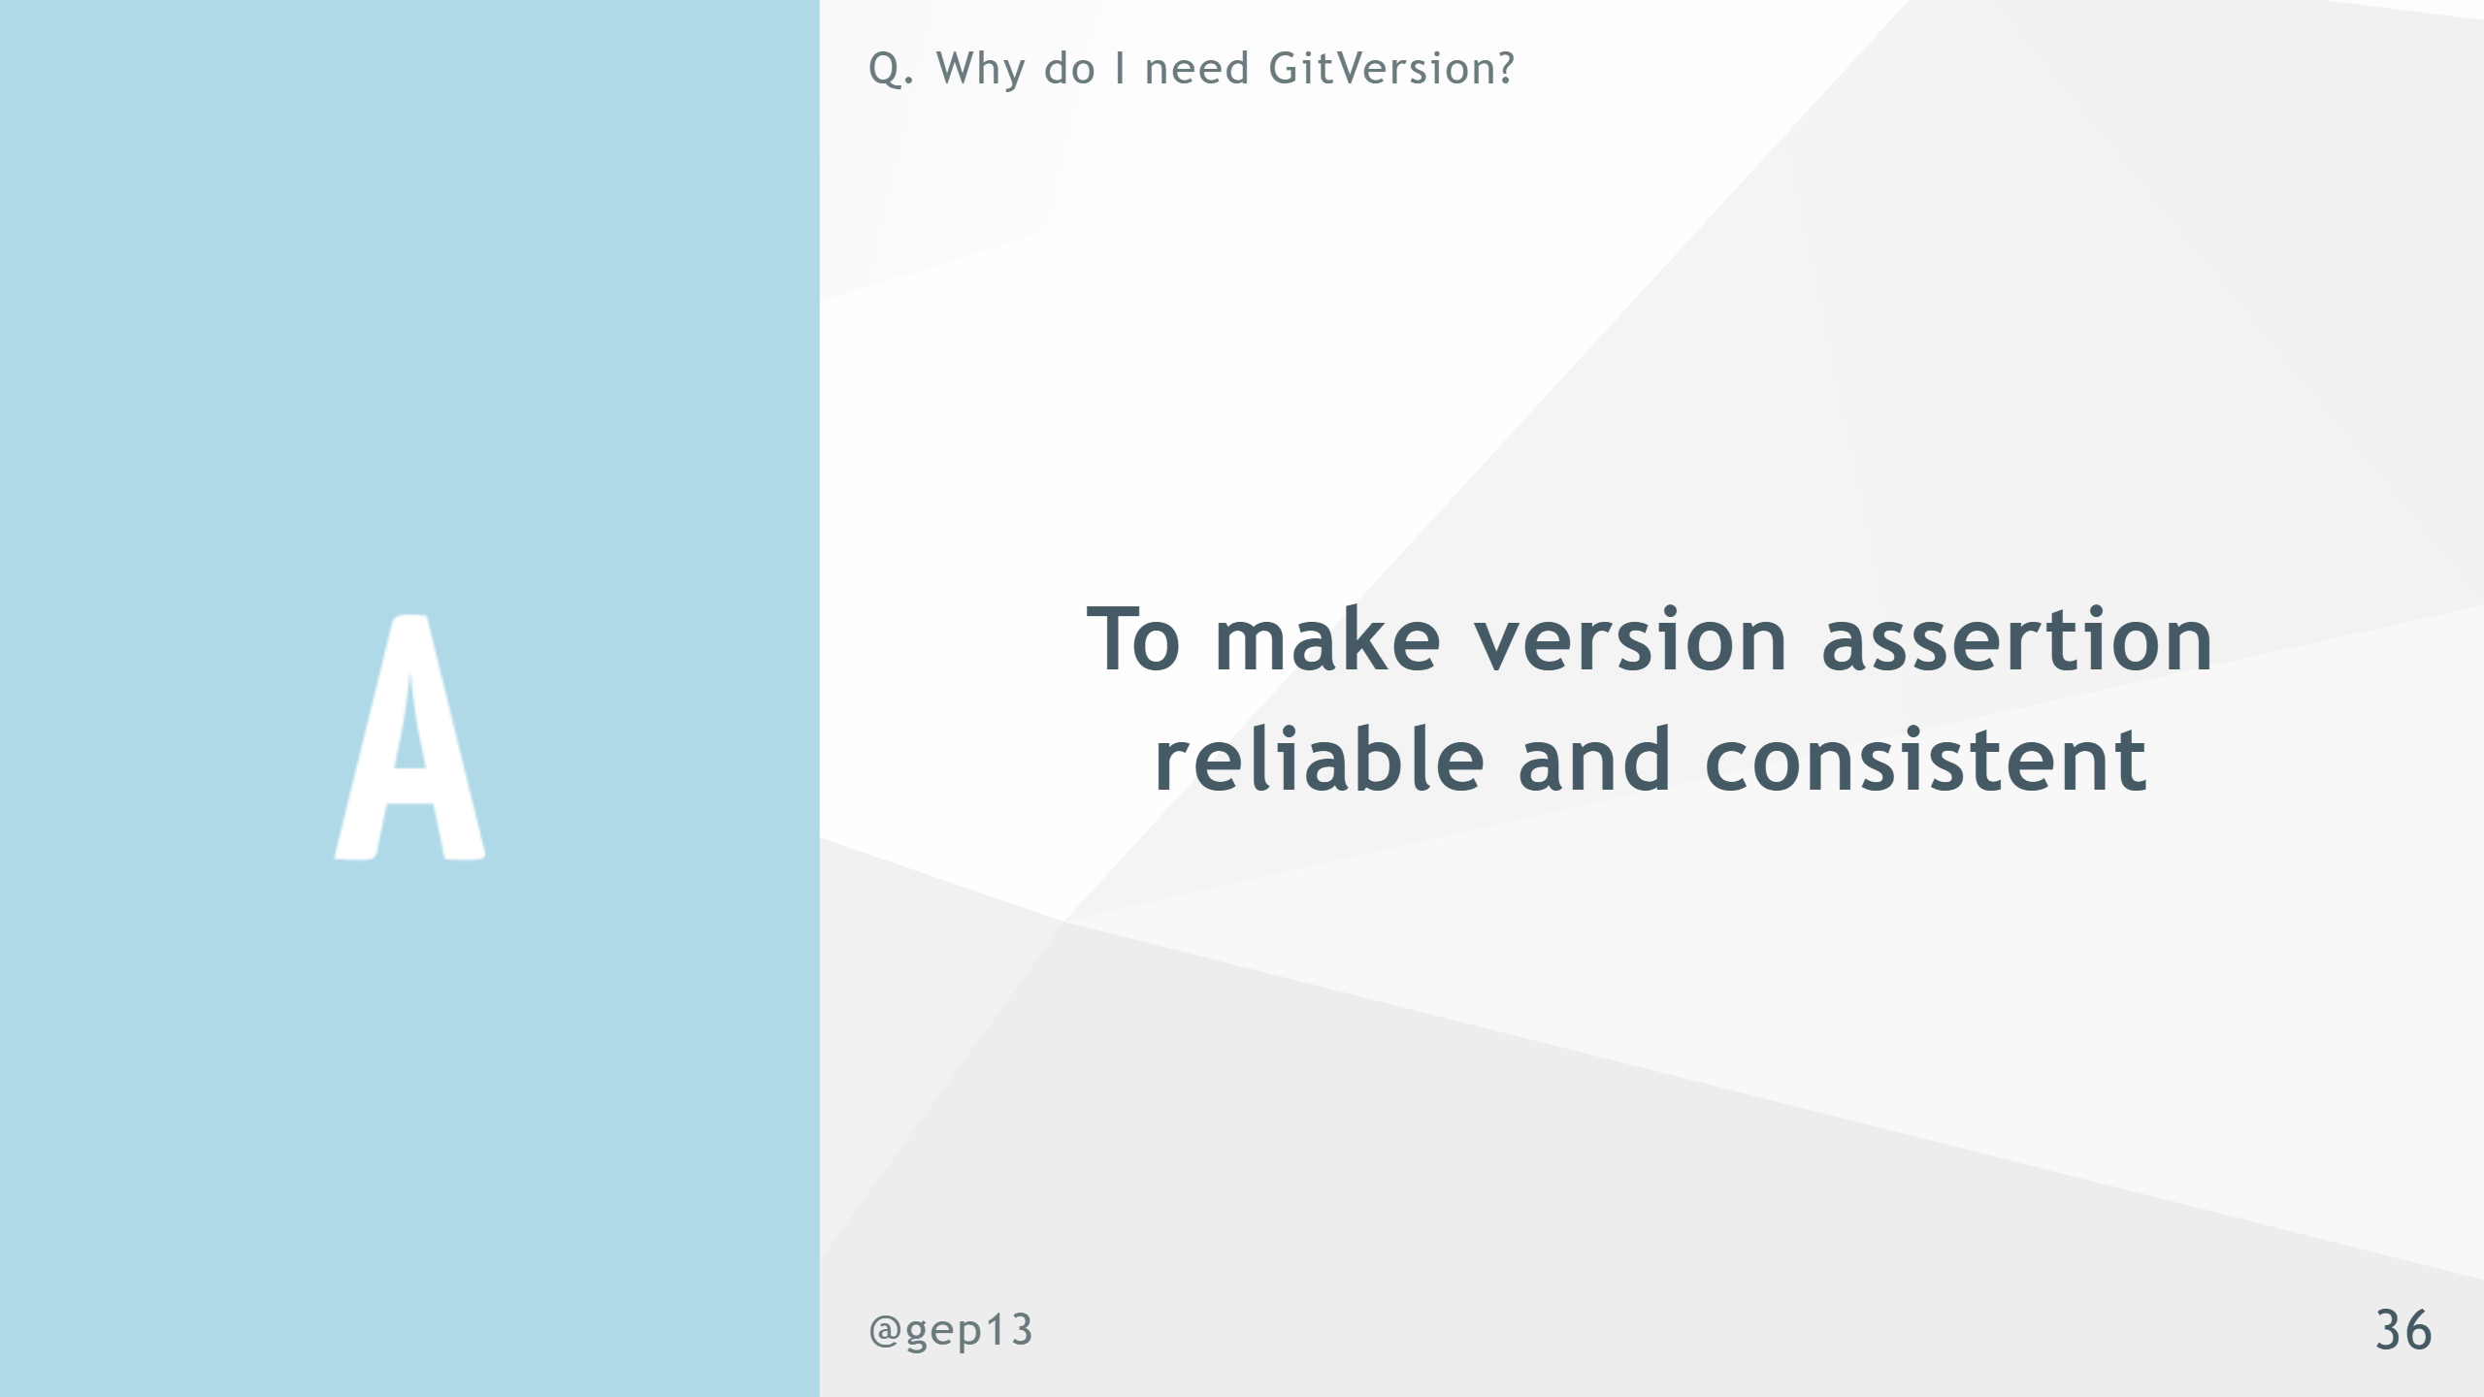

Slide 37


Slide 38
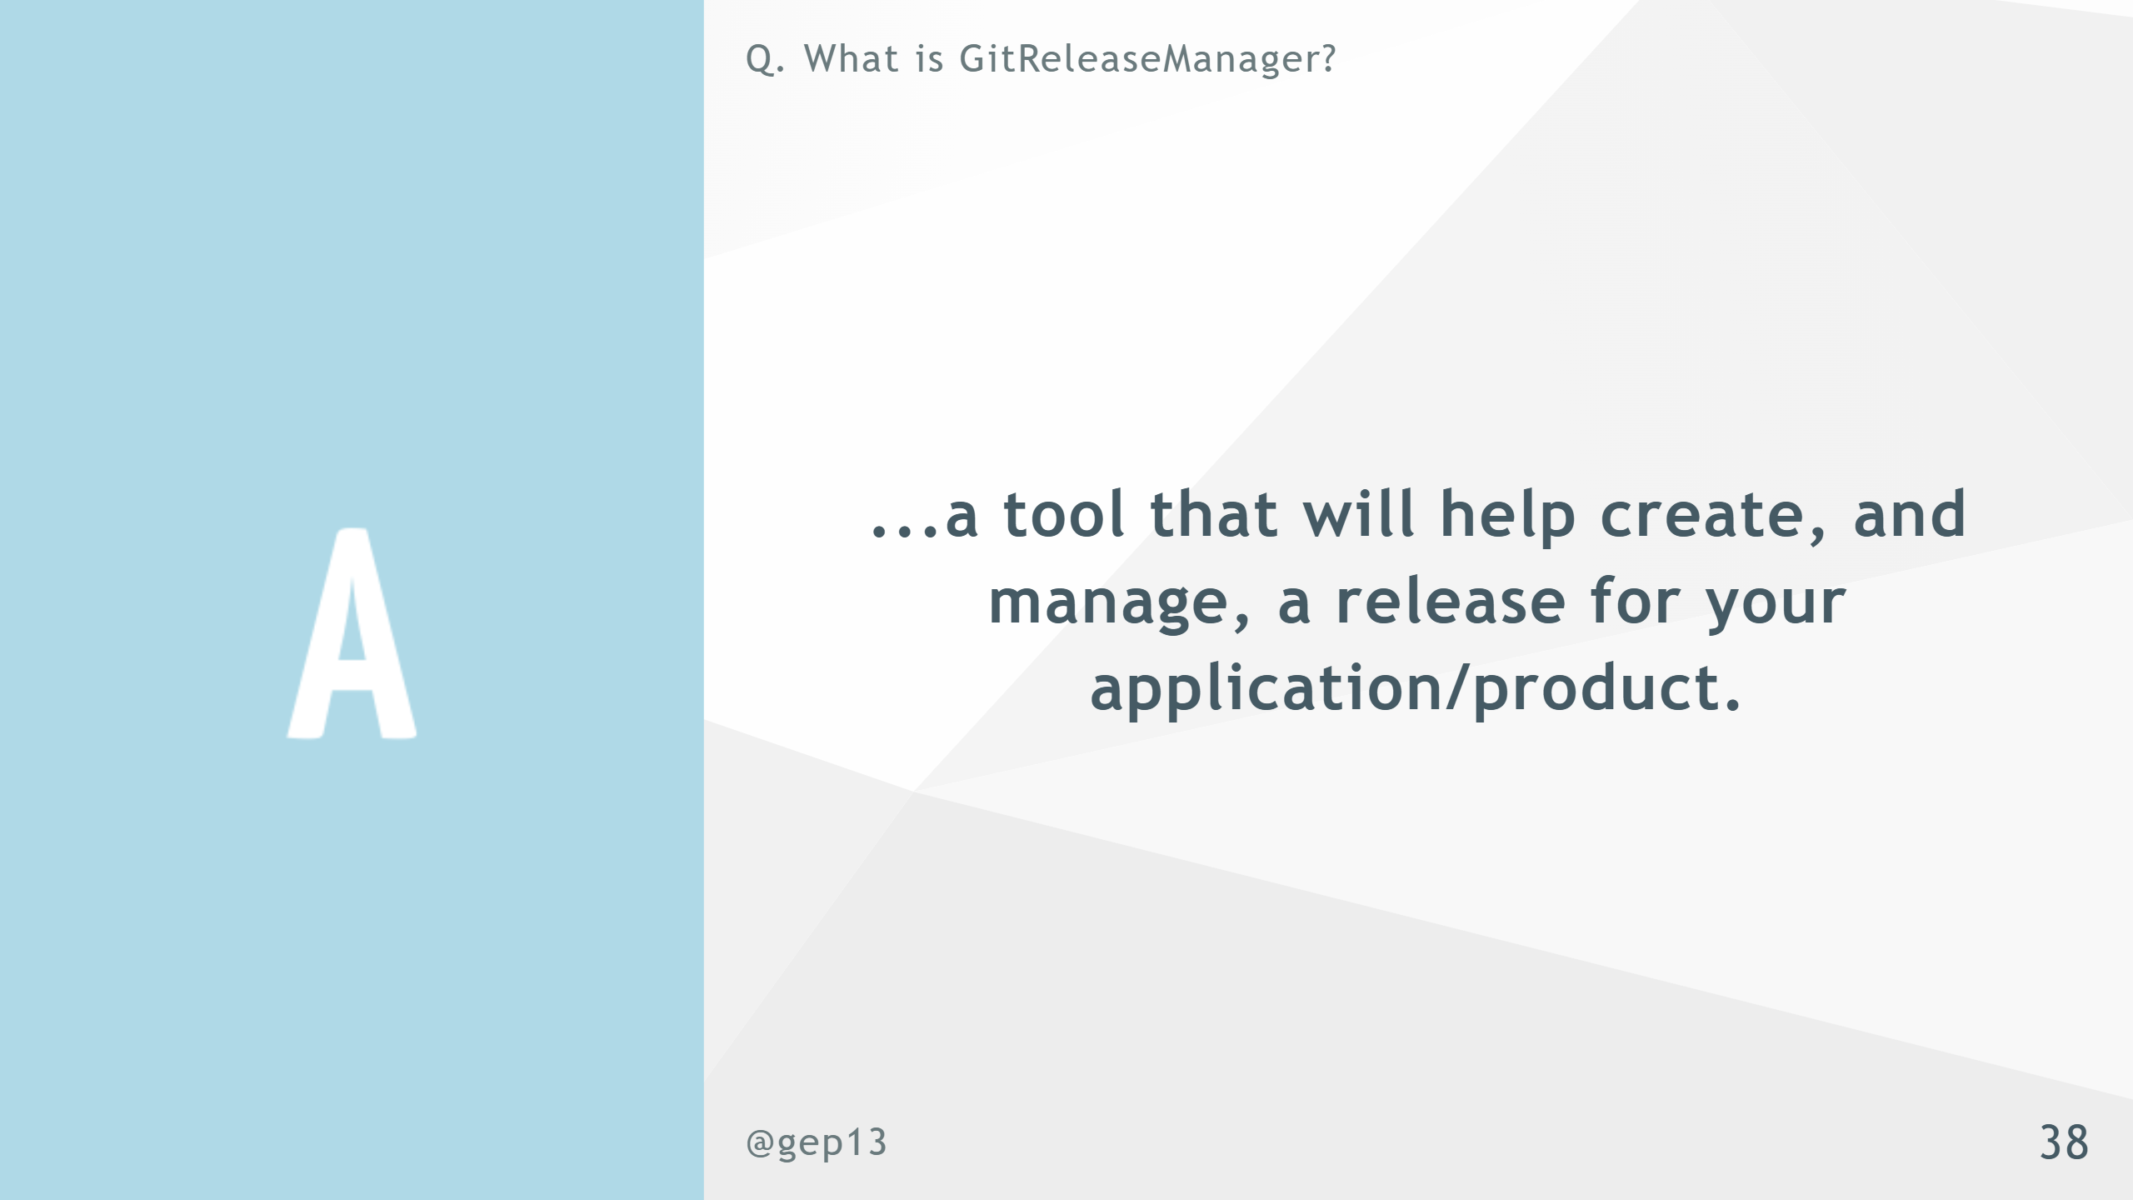
Notes:
- Started out as a tool from Particular - .Net Framework - .Net Global Tool - GitHub Action

Slide 40


Slide 41


Slide 42
